Slide 1
FINAL PROJECT TOPIC:
EVALUATING POSTGRESQL
AUTHENTICATION HARDENING
Against Known-Credential Exploitation in a Containerized Stack
RESEARCH FOCUS
Credential rotation • SCRAM-SHA-256 • pg_hba.conf • remote access
Authorized local/classroom laboratory environment
GITHUB REPO: https://github.com/favourebefa/Final-Project_postgresql-authentication-hardening.git
Presented By
Favour Ebefa E.
Submitted to Instructor’s
Mr. Joshua and Mr. Sadiq

Slide 2
01 • EXECUTIVE SUMMARY
THE SECURITY PROBLEM
A valid known credential can still work when PostgreSQL is reachable and its access rules permit the connection.
BASELINE
HARDENING
AFTER
CONTROL
ALLOW
ROTATE
DENY
RESTRICT
Known credential authenticated remotely.
Credential replaced; SCRAM retained.
Known credential no longer authenticated.
HBA limits permitted sources.
Core finding: SCRAM was already active — the tested improvement came from layered controls.
POSTGRESQL AUTHENTICATION HARDENING • FINAL PROJECT

Slide 3
02 • RESEARCH DESIGN
RESEARCH QUESTION & HYPOTHESIS
RESEARCH QUESTION
To what extent do SCRAM-SHA-256 authentication and restrictive pg_hba.conf rules prevent unauthorized remote PostgreSQL connections using a previously known credential in a containerized environment?
HYPOTHESIS
SUCCESS CONDITION
Credential rotation combined with restrictive HBA rules will reduce successful remote authentication using the previously known credential while preserving authorized access.
Known credential → DENY
Replacement credential → ALLOW
HBA mismatch → DENY
POSTGRESQL AUTHENTICATION HARDENING • FINAL PROJECT

Slide 4
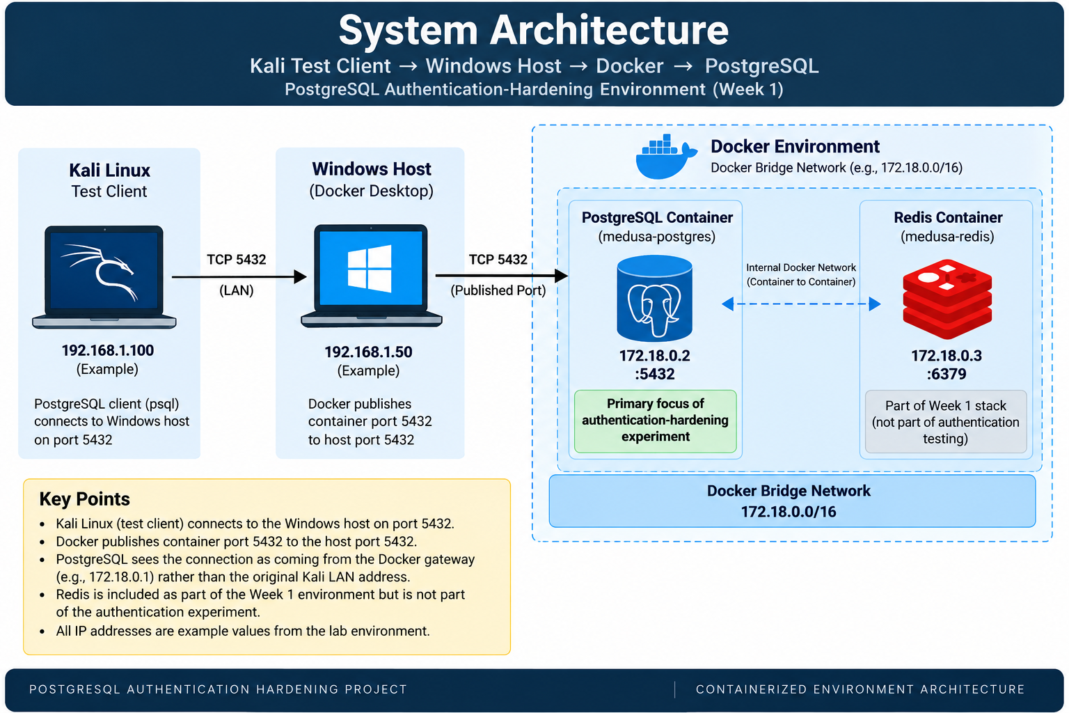
03 • ENVIRONMENT
EXPERIMENTAL ARCHITECTURE
Primary experiment: Docker PostgreSQL. Supplementary validation: direct-LAN PostgreSQL on Kali.
POSTGRESQL AUTHENTICATION HARDENING • FINAL PROJECT

Slide 5
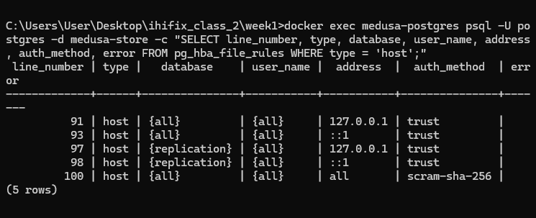
04 • BEFORE
PostgreSQL HBA CONFIGURATION
Baseline host authentication included a broad remote rule using SCRAM-SHA-256.
POSTGRESQL AUTHENTICATION HARDENING • FINAL PROJECT

Slide 6
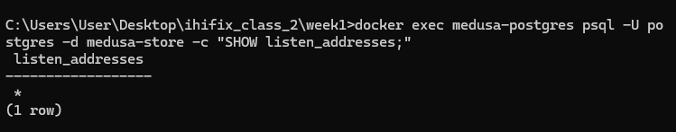
05 • BEFORE
PostgreSQL LISTENING CONFIGURATION
The database was listening on all available addresses.
POSTGRESQL AUTHENTICATION HARDENING • FINAL PROJECT

Slide 7
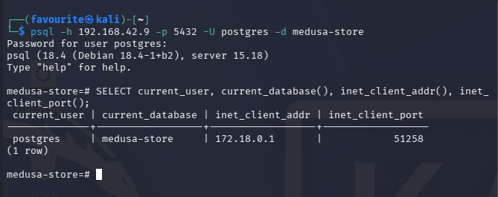
07 • BEFORE
Remote authentication — SUCCESS
The authorized Kali client connected to the Docker PostgreSQL service using the previously known laboratory credential.
BASELINE RESULT: REMOTE AUTHENTICATION SUCCESS
POSTGRESQL AUTHENTICATION HARDENING • FINAL PROJECT
08

Slide 8
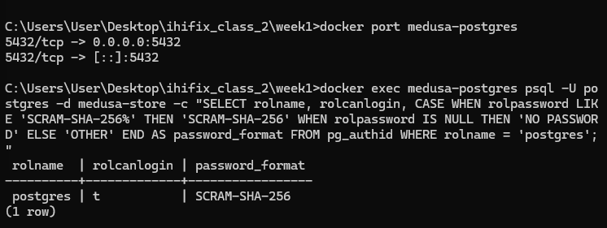
08 • BEFORE
SCRAM-SHA-256 was already active
The baseline verifier confirms that the project did not introduce SCRAM as a new control.
E-004 • T-001
IMPORTANT: SCRAM RETAINED, NOT INTRODUCED
POSTGRESQL AUTHENTICATION HARDENING • FINAL PROJECT

Slide 9
09 • HARDENING
WHAT CHANGED AFTER THE BASELINE
The intervention targeted credential validity and source authorization while retaining SCRAM-SHA-256.
01
02
03
Rotate credential
Retain SCRAM
Restrict HBA
Invalidate the previously known credential.
Keep SCRAM-SHA-256 active.
Limit permitted source address.
04
05
Reload & verify
Retest
Apply and inspect active rules.
Verify ALLOW and DENY conditions.
POSTGRESQL AUTHENTICATION HARDENING • FINAL PROJECT

Slide 10
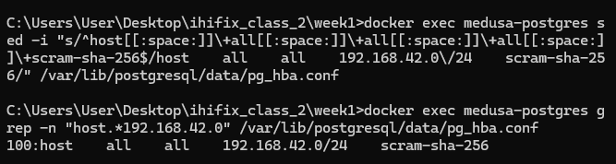
10 • AFTER
RESTRICTIVE HBA RULE APPLIED
The source restriction was tested during hardening; Docker source-address behavior had to be accounted for.
HBA: SOURCE-BASED ACCESS CONTROL
POSTGRESQL AUTHENTICATION HARDENING • FINAL PROJECT

Slide 11
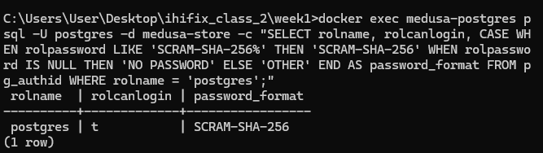
11 • AFTER
SCRAM-SHA-256 RETAINED AFTER ROTATION
The authentication mechanism remained SCRAM-SHA-256 after the credential change.
AUTHENTICATION: SCRAM-SHA-256 RETAINED
POSTGRESQL AUTHENTICATION HARDENING • FINAL PROJECT

Slide 12
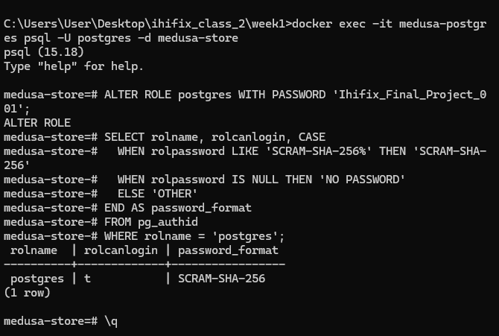
12 • AFTER
CONFIGURATION RELOAD SUCCEEDED
PostgreSQL accepted the configuration reload after the HBA change.
CONFIGURATION: RELOADED SUCCESSFULLY
POSTGRESQL AUTHENTICATION HARDENING • FINAL PROJECT

Slide 13
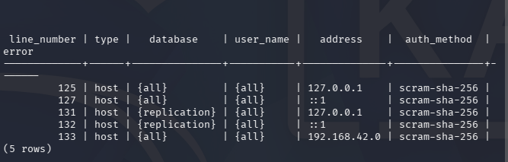
13 • AFTER
FINAL HBA CONFIGURATION
The final active HBA rule was verified without reported configuration errors.
FINAL CONTROL STATE: VERIFIED
POSTGRESQL AUTHENTICATION HARDENING • FINAL PROJECT

Slide 14
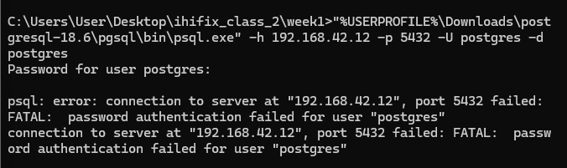
14 • AFTER
PREVIOUSLY KNOWN CREDENTIAL — DENIED
The previously known credential failed after credential rotation in the supplementary direct-LAN validation.
KNOWN CREDENTIAL: ALLOW → DENY
POSTGRESQL AUTHENTICATION HARDENING • FINAL PROJECT

Slide 15
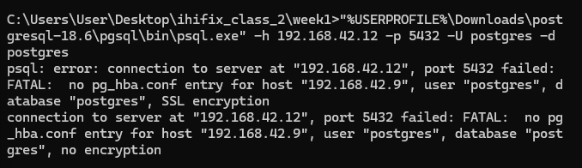
15 • NETWORK VALIDATION
HBA DENIAL — SOURCE NOT PERMITTED
A source excluded by the HBA rule received a no-pg_hba.conf-entry denial.
HBA MISMATCH: CONNECTION DENIED
POSTGRESQL AUTHENTICATION HARDENING • FINAL PROJECT

Slide 16
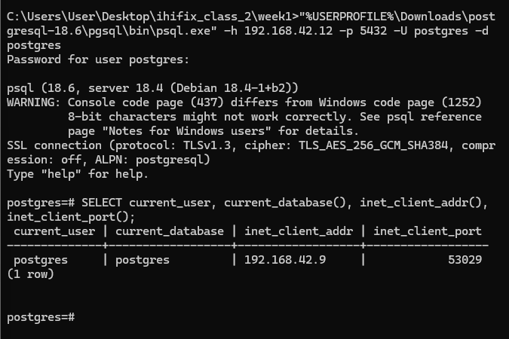
16 • NETWORK VALIDATION
DIRECT-LAN SOURCE ADDRESS VALIDATION
The supplementary direct-LAN test showed PostgreSQL observing the Windows host's actual LAN address.
DIRECT-LAN SOURCE: 192.168.42.9
POSTGRESQL AUTHENTICATION HARDENING • FINAL PROJECT

Slide 17
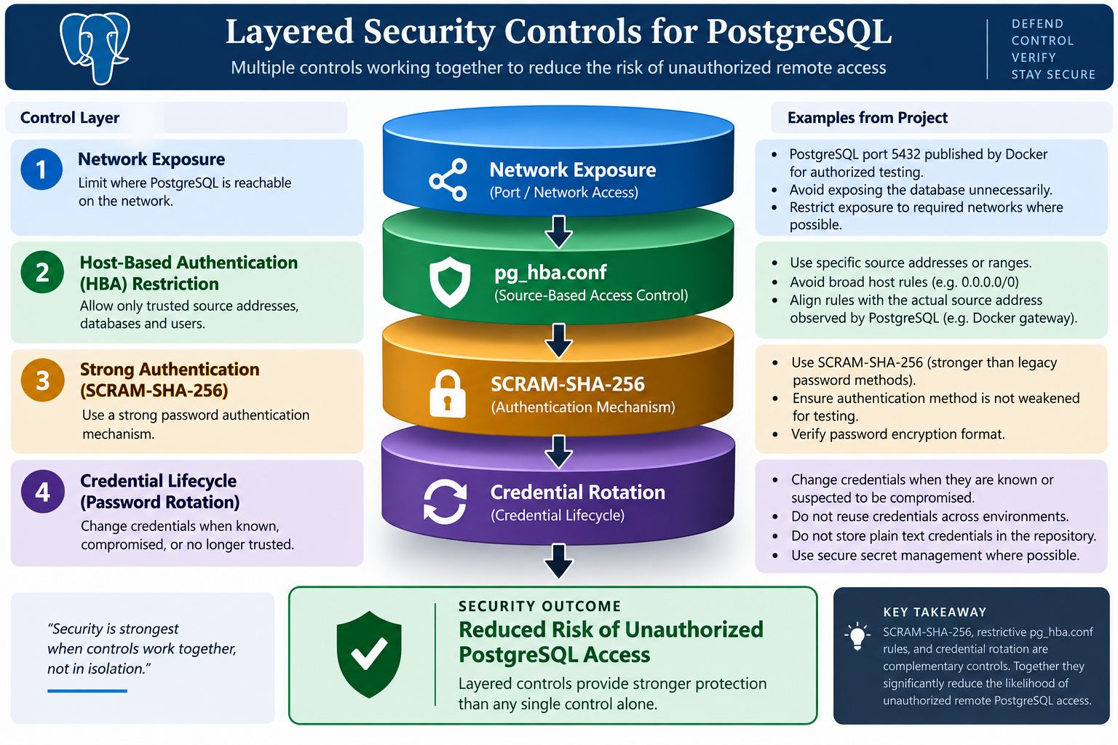
17 • CONTROL MODEL
LAYERED SECURITY CONTROLS
Each layer addresses a different part of the remote-access path.
POSTGRESQL AUTHENTICATION HARDENING • FINAL PROJECT

Slide 18
18 • CONCLUSION
WHAT THE EVIDENCE SUPPORTS
The tested known-credential access path was reduced through layered hardening.
• SCRAM-SHA-256 was already active and remained active.
• Credential rotation invalidated the previously known credential.
• Restrictive HBA rules denied excluded connection sources.
• Docker networking made source-address verification essential.
KEY TAKEAWAY | Strong authentication + credential hygiene + network restriction = stronger defense.
POSTGRESQL AUTHENTICATION HARDENING • FINAL PROJECT

Slide 19
THANK YOU

